Slide 2


Forwarding methods
Packet switching
Circuit switching
Store and forward: entire packet must arrive at router before it can be transmitted on next link
End-to-end resources reserved for the duration of transmission
TDMA
FDMA
Bandwidth
Time
Time
Notes:
I: work on how to smoothly present this and the next slide
Q: human analogies of reserved resources (circuit switching) versus on-demand allocation (packet-switching)?

Slide 3
Packet vs. Circuit switching
Which gives better performance in terms of:
End-to-end delay?
Flow throughput?
Network throughput?
Packet switching
Circuit switching
+ More efficient with bursty data
+ Simpler – no call setup
– Variable delay
– Need protocols for reliability and congestion control
+ Lower end-to-end delay
– Wastes resources during quiet periods
– Need protocols for resource reservation

Slide 4


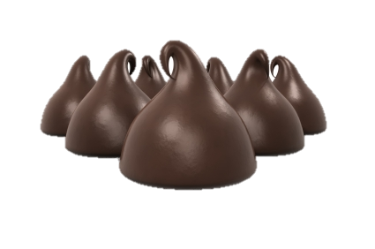


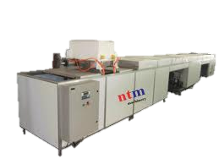


Network performance
Medium access
Sources of delay:
Processing
Queuing
Serialization
Propagation
Sources of loss:
Buffer overflow
Interference
Notes:
?: Ask students to explain the sources of delay in terms of the chocolate chip making process

Slide 5
Definitions of delay
Processing delay
The time it takes to read an incoming packet, determine on which link to transmit the packet, and to form packet headers.
Analogy: The time to set up the chocolate chip making machine.
Queueing delay
The time it takes for the packet to get to the front of the queue.
Analogy: The time to finish a run of white chocolate chips to start the regular chips.
Medium access delay
The time a packet has to wait at the front of the queue for the transmission medium to be free.
Analogy: Wait for the conveyor to reach the correct speed.
Serialization delay
The time it takes to put all the packet’s bits onto the transmission medium.
Analogy: The time to drip down a batch of chocolate chips.
Propagation delay
The time it takes for the first bit of a packet to traverse a link
Analogy: The time it takes for the first line of chocolate chips to cool before they are packed at the end of the conveyor.
Notes:
i: students asked for definitions – maybe don’t go over them in detail, but give them out in a handout

Slide 6
Definitions of loss
Buffer overflow
When the rate of arriving packets exceeds sending rate packets queue up. Eventually the number of queued packets exceeds queue size in router memory and newly arriving packets are dropped.
Analogy: The box collecting chips at the end of the conveyor fills up and new chips are dropped on the floor. (No three seconds rule!)
Interference
When a transmitted packet collides with another packet on the transmission medium and neither one can be decoded.
Analogy: Someone snags a chip of the conveyor belt.

Slide 7
Likely sources of delay
Core ISP network
Cellular network
Medium access
Sources of delay:
Processing
Queuing
Serialization
Propagation
Wi-Fi network
Sources of loss:
Buffer overflow
Interference

Slide 8
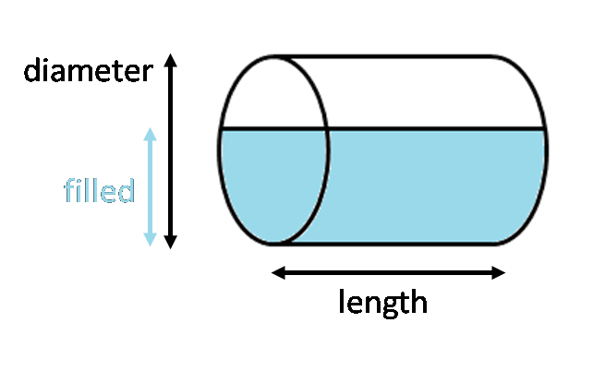
Network performance
Loss of throughput:
Low capacity link
Congested link
Bottleneck links
1.5 Mbps
1 Mbps
Metrics of delivery rate:
Capacity – bandwidth, serialization rate, thickness of the pipe
Available bandwidth – unutilized bandwidth
Achievable throughput – share of capacity achieved by a flow
Goodput – rate of delivered application payload data

Slide 9
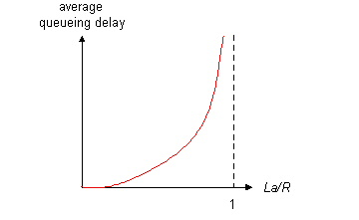



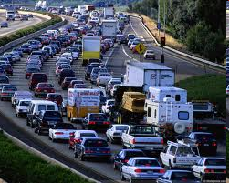
Illustration of queuing delay
B: link bandwidth (bps)
L: packet length (bits)
A: average packet arrival rate
LA/B ~ 0:
Small queuing delay
LA/B → 1:
Large queuing delay
LA/B > 1:
More “work” arriving than can be serviced
Queuing delay infinite!
Assuming bursty arrival rate, would large router buffers improve, or degrade network performance?
LA/B
Notes:
Why not make route buffers infinite?: unbounded delay, no incentive/feedback to reduce transmission rate making the problem worse
Is it enough to keep traffic intensity <1 over time to avoid buffer losses?

